Slide 1

DNA Cryptography based Speech Security System Shaikh Akib Shahriyar, Shovan Bhowmik , and Mahedi Hasan
International e-Conference on Intelligent Signals and Signal Processing (e-ISSP 2020)
Department of Computer Science and Engineering,
Khulna University of Engineering & Technology (KUET),
Bangladesh.

Slide 2
Outline
Introduction
DNA Encoding
DNA Cryptography based Speech Security System (SSS)
Proposed Architecture of SSS
Experimental Setup
Encryption Stage
Decryption Stage
Experimental Analysis
Limitation and Future Scope
Conclusion

Slide 3
Introduction
Speech is one of the most vital forms of communication in today’s age.
Because of it’s massive availability, vulnerability to interruption or eavesdrop has also increased.
To establish privacy on communication devices, several security algorithms are available. For e.g. A3, A5, A8.
A reliable way of transferring speech into a secured form is proposed with the help of DNA cryptography.
The proposed Speech Security System (SSS) is significantly robust against any cryptanalytic, statistical, and brute force attacks by an intruder and thus improves the security of the speech signals.
(Eavesdropping sustains!)

Slide 4
DNA Encoding
DNA(Deoxyribonucleotides) is the genetic structure that carries the genetic information of every living creature on the earth.
It is a particular form of plastic consisting of several monomers (deoxyribose sugar, a phosphate group, and a nitrogenous base).
These nitrogenous bases are separated into two vast categories namely Purins (Adenine [A], Guanine[G]) and Pyrimidines (Cytosine [C], Thymine [T]).
DNA string has an exceptional characteristic: one cannot differentiate a real DNA string from a dupe one.
This exceptional characteristic has been utilized in this work to ensure speech security.

Slide 5
DNA Cryptography Based Speech Security System (SSS)
A secured encryption (Transmitter end) and decryption (Receiver End) method based on DNA cryptography is proposed.
A DNA sequence (obtainable from public database) will be familiar to both transmitter and receiver.
The source sequence P is integrated with the transmitter’s hidden information M and then reconstructs into a new encrypted signal P´.
This signal P´ along with the received string is inspected and resolved to retrieve transmitter’s hidden information M.
It is presumed here that the secret message M is a binary string of the speech signal accepted over GSM.

Slide 6
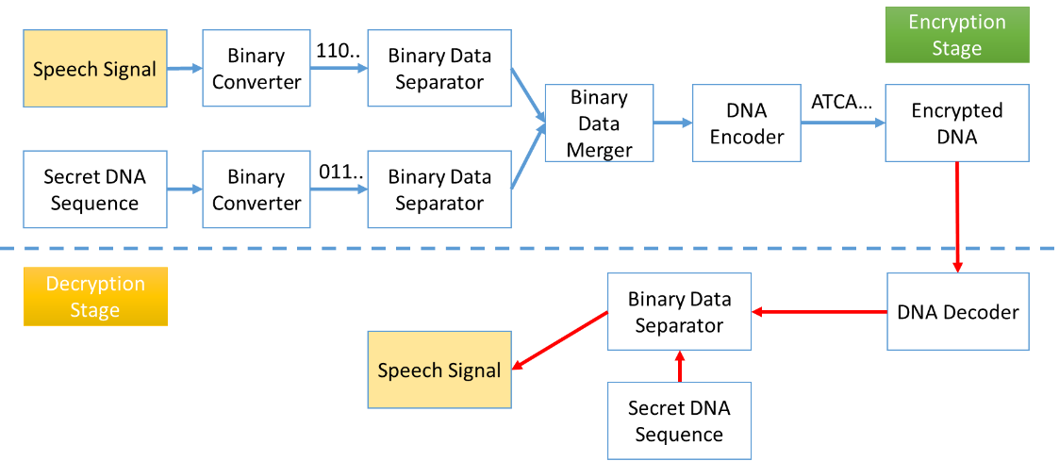
Proposed Architecture of SSS

Slide 7
Experimental Setup
Linux Environment (Ubuntu 16.10)
8GB RAM
Python 3.6
PyAudioAnalysis Tool

Slide 8
Encryption Stage(1/3)
The proposed Speech Security System can encrypt any speech signal into an encrypted DNA sequence.
Step 1: Binary Converter transforms the selected speech signal M in a binary sequence (using the pyAudioAnalysis tool) and a secret DNA strand P is taken.
Step 2: The secret DNA sequence P is transformed into a binary sequence.
M = 1110011110010110000001011000001110010001
Generated Random Number, n = 4. Corresponding binary digits of A, G, T and C are 00, 11, 10 and 01 respectively.

Slide 9
Encryption Stage(2/3)
Step 3: M is split into n number of segments.
Step 4: Binary signal of DNA sequence P is split into n number of segments.
‘0’ is added to start of every segment.
If last segment contains less than n digits, then k number of ‘0’ is padded.

Slide 10
Encryption Stage(3/3)
Step 5: Each i-th segment of P is merged after each i-th segment of M and a mixed binary sequence is generated.
Step 6: The binary sequence is encoded into DNA series by the DNA encoder and encrypted DNA sequence is formed.
The encrypted DNA sequence is = CGCA TCGC TCAT AACT ACAA CTTC CTGC AATA AGAG CATC AACTC
Step 7: The receiver receives an encrypted DNA sequence and the secret key is (P,n,k).

Slide 11
Decryption Stage(1/2)
The DNA strand is decrypted at the receiver end and the original speech signal is retrieved.
Step 1: DNA decoder translates the received encoded DNA series into a binary series.
Step 2: Based on input of confidential DNA sequence and random number n, the binary series is split into equal number of groups.
Each segment size is 2n

Slide 12
Decryption Stage(2/2)
Step 3: For each i-th segment of the sequence, the first n bits are truncated which denotes the i-th part of M and the last n bits are matched with the i-th segment of P. The method is followed iteratively to eliminate the segments of P from the whole chain and to obtain segments of M.
Step 4: From each segment of M, ‘0’ is truncated from the beginning and the rest part of the segments are concatenated to retrieved the original speech signal M.

Slide 13
Experimental Analysis (1/3)
The proposed SSS has been rigorously tested with different kinds of audio signals that are usually transferred over the cellular network.
To check the robustness (ability to withstand different kinds of cryptanalytic attacks) of the encryption method, thorough cryptanalysis of SSS is performed.
Key Space Analysis
The DNA sequence needed for encryption of any audio signal can be sampled from vast search space of 55 million samples.
Arbitrary DNA sequences can be constructed based on the preference of the sender and receiver.
Hard for an attacker to retrieve the DNA sequence used for encryption by brute force.

Slide 14
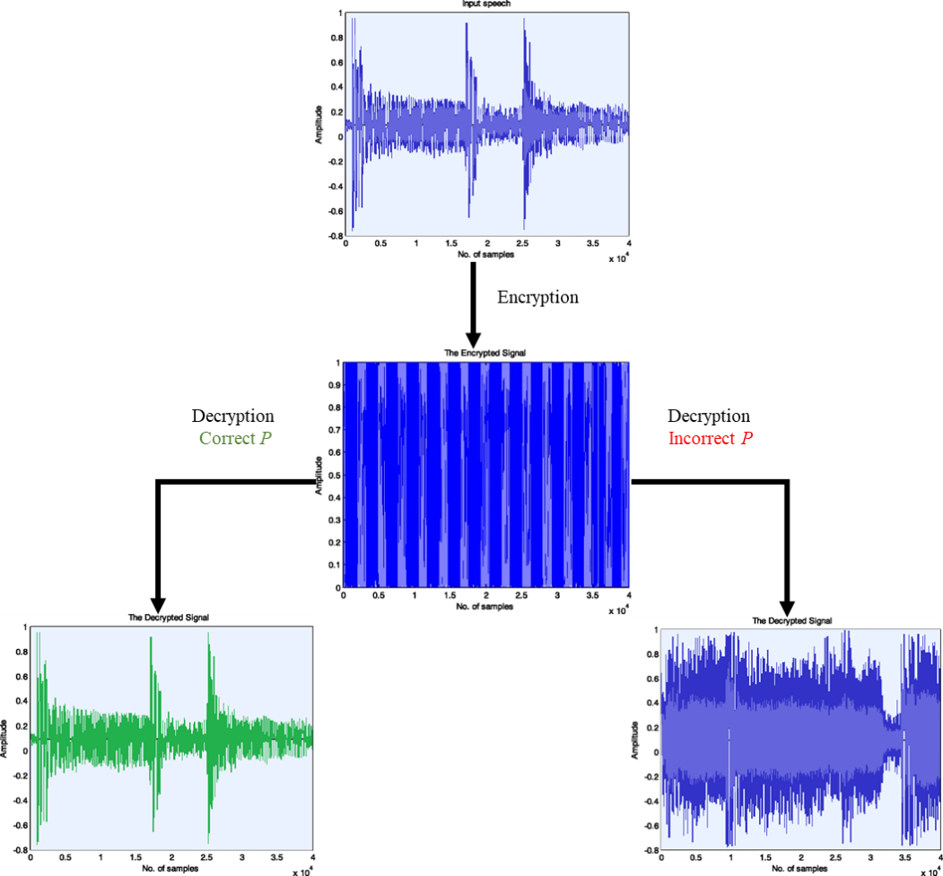
Experimental Analysis (2/3)
Histogram Analysis
Speech signals can be analyzed to understand the underlying distribution of samples at different time-steps.
The encryption done by the proposed SSS has completely changed the input signal to a degree that no statistical attack can be performed on the proposed SSS.

Slide 15
Experimental Analysis (3/3)
Key Sensitivity Analysis
Having a high key sensitivity is a core requirement of any cryptography-based security system.
It refers to the process that the encrypted signal cannot be decrypted accurately even if there is a small difference between the encryption and decryption keys.

Slide 16
Limitation and Future Scope
Limitation
Prior knowledge of seed value is required for both sender and receiver.
Remedy: Public key cryptography systems can be used to transfer seed value from transmitter to receiver.
Future Scope
It can create a great impact on securing the transmitted voice-over mobile networks or other forms of speech signal sharing platform.

Slide 17
Conclusion
The proposed speech security system provides a robust method to secure speech signals.
The simple and effective DNA cryptographic scheme plays a vital role in the proposed SSS.
Our proposed SSS has a set of significant features which helps it to stand out among other speech encryption system.
Through rigorous cryptanalysis, the proposed SSS stands strong against different cryptanalytic, statistical, and brute force attacks.
Our proposed SSS can be incorporated into current security solutions available in the cellular signal transfer domain to further strengthen the security of the overall system.

Slide 18
Thank You

